Slide 1


Slide 2
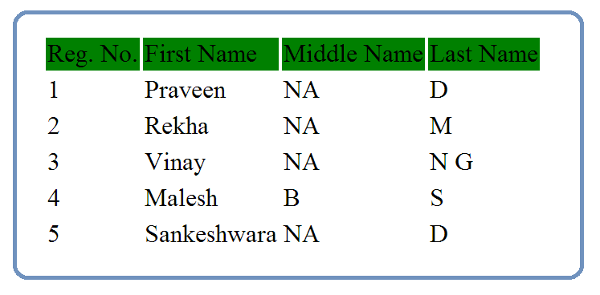

Slide 3
Java
JDBC
DB

Slide 4
Plain Java Program
with main() method
Java
JDBC
DB
1. Load the Driver
2. Get the DB Connection via Driver
3. Issue SQL Queries via Connection
select * from students_info
4. Process the Results
Print the Data in Console
5. Close All JDBC Objects

